Slide 1
CSCI 561 Foundations of Artificial Intelligence Lecture 18-19: Quantifying Uncertainty (Chapter 13-14)
Contains extra slides that have blue titles
FALL 2018
Instructor:
Prof Sheila Tejada, Wei-Min Shen
cs561-l@mymaillists.usc.edu

Slide 2
Uncertainty Coping with What You Don’t Grasp
Outside scope of awareness
Beyond range of sensors (partial observability)
In the future and incompletely predictable
In the past but prehistoric (no relevant memory)
Too complex to reason about in complete detail
Reasoning may need to be incomplete
Reasoning may need to be abstracted
Too expensive or risky to ensure certainty
E.g., medical diagnostic procedures or military questions
Problem/information has inherent randomness

Slide 3

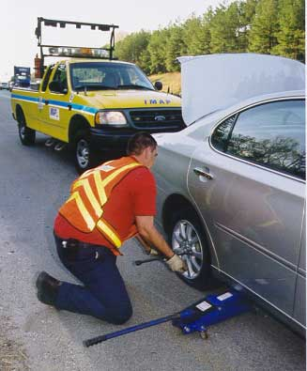
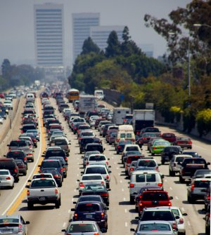
Example When to Leave for Airport?
Requires understanding how long it is likely to take to get there (mean), and how likely there is to be a significant deviation from this expectation (variance)
Leads to decision making under significant uncertainty
A range of possible causes for this uncertainty
Partial observability
State of roads, other drivers’ plans, etc.
Noisy sensors (introducing errors, not just lack of info)
Traffic reports, etc.
Uncertainty in action outcomes
Flat tire, accident, etc.
Uncertainty about how traffic will evolve over time
Complexity of modeling and predicting traffic

Slide 4
Logic and Uncertainty
Logic generally talks in terms of certainty
A fact is either true or false
Although may be unknown as a very generic form of uncertainty
A rule applies to all cases or not
Need at times to be able to talk instead about how (un)certain you are about something
Default Logics enable one form of this
Can talk about something as being consistent, as a weaker statement than that something is true
But often need more shades of meaning than this
Risk either stating things as true that are false or leaving as unknown something about which key information is known

Slide 5
Airport Example (Cont.)
Can we state with certainty that leaving for the airport 30 minutes ahead will get us there on time?
No!
Must we leave for the airport 5 hours ahead because we can’t state with certainty that leaving earlier will get us there on time?
I hope not!
Instead need to represent and reason about likelihoods of various events and outcomes
Probability is the standard means of formalizing and reasoning about likelihood

Slide 6
Probability (extra slide)
What is probability?
Where is probability? (in the world or in your mind)
Notation:
variable X, value x_{i}, P(X=x_{i}),
P(X) denotes a distribution on all values of X, P(X,Y), P(X,y)
Remember two axioms (all can be derived from here!)
Sum axiom: P(A|B)+P(~A|B)=1
Product axiom: P(AB|C)=P(A|C)P(B|AC)=P(B|C)P(A|BC)
Probability can do much more than logics
Deductive reasoning (logic and probability):
If A->B and A, then B (forward reasoning)
If A->B and ~B, then ~A (resolution)
Inductive reasoning (probability):
If A->B and ~A, then “B become less plausible”
If A->B and B, then “A become more plausible”
If A->”B becomes more plausible” and B, then “A become more plausible”
Causal Reasoning
Evidential Reasoning

Slide 7
Probability
“Probability is the chance that something is likely to happen or be the case.” (Wikipedia)
This is objective probability
E.g., P(heads)=P(tails)=1/2
Our focus will be on subjective probability
An agent’s estimated likelihood of the truth of a sentence
Modal/meta-level knowledge about a sentence, rather than knowledge directly about the world
E.g., ‘I believe that the chance is .35 that the sentence “It will take 25 minutes to get to the airport” is true’
Probabilistic assertions summarize effects of
Laziness: failure to enumerate exceptions, qualifications, etc.
Ignorance: lack of relevant facts, initial conditions, etc.
Approach is to summarize over all of these effects even without fully understanding them
“Quantifying ignorance”

Slide 8
Example (extra): Seeing is NOT (always) Believing!
You define two “logic” (random) variables for two propositions:
X: “my eyes see the object”
Y: “the object is really there”
Your real experience is as follows:
X = [1, 1, 0, 1, 0, 1, 1, 0, 0, 1, 1, 1]
Y = [1, 1, 1, 0, 0, 1, 1, 0, 0, 0, 1, 1]
Definition of probabilities
P(X): the probability of “my eyes see the object”
P(Y): the probability of “the object is really there”
P(Y^X): the probability that “the object is really there AND my eyes see the object”
P(Y|X): the probability that “the object is really there IF my eyes see the object”
Computing the probability
P(X) = 8/12, P(Y) = 7/12, P(X^Y) = P(XY) = 6/12, … (based on counting)
In common sense, “Seeing is Believing” ⬄ P(Y|X)=1.0
But P(Y|X) = ??? [this and others are what we will learn]

Slide 9
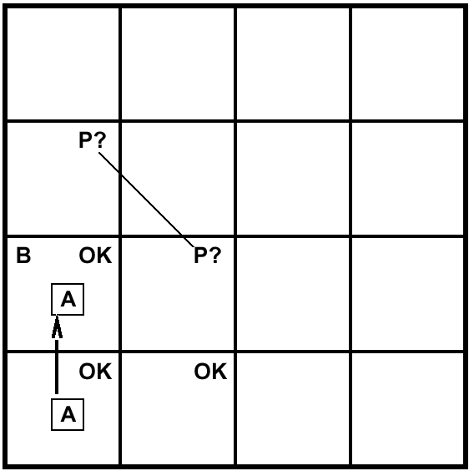
Example: Guessing a Pit
A= Agent
B= Breeze
S= Smell
P= Pit
W= Wumpus
OK = Safe
V = Visited
G = Glitter
Which one has a PIT?
B
P?
Logic can only guess randomly which of [1,3],[2,2],[3,1] has a pit
Using probability you can calculate which one is more likely have a pit than others

Slide 10
Two Key Elements in Probability (Extra slide)
Probability Distribution Model
Variables, Value assignments (possible worlds)
Represented as a table or a graph
Inferences can be made from the model
Sum rule
Product rule
Conditional
Marginalization
Normalization

Slide 11

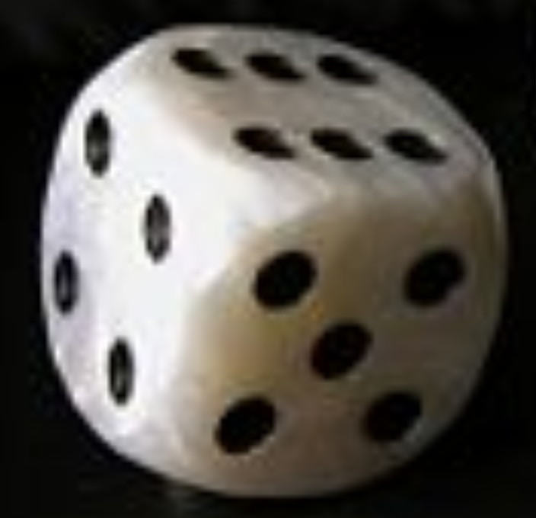
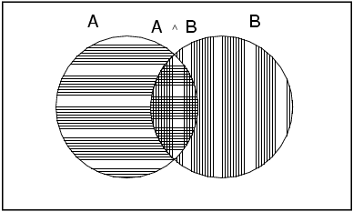
Basic Concepts of Probability
1.
P(x) is a real number in [0, 1]
that represents the likelihood that x is true
P(x)=1 ⇒ Certainty
P(true)=1
P(x)=0 ⇒ Impossibility
P(false)=0
0<P(x)<1 ⇒ Uncertainty (varying levels)
For a fair coin, P(heads)=P(tails)=.5
For a fair die, P(1)=…=P(6)=.166…
P(A ∨ B) = P(A) + P(B) - P(A ∧ B)
.
Notes:
How many have had a previous introduction to probability?

Slide 12
More on Probability
P(x∧y)=P(x)P(y) if x and y are independent
P(heads¹∧heads²)=P(heads¹)P(heads²)=.5*.5=.25
P(AinCourse∧Raining)=P(AinCourse)P(Raining)
No general way to compute when not independent, except…
P(x∧y)=0 if x and y are mutually exclusive
P(AinCourse∧BinCourse)=0
P(x∧¬x)=0
Makes P(x∨y)=P(x)+P(y) by Axiom 3
P(x)=P(y) if x=y (logically equivalent)
P(x₁∨…∨x_{n})=1 if the x_{i}’s are exhaustive
P(heads ∨ tails)=1
P(x∨¬x)=1
P(¬x)=1-P(x)
1=P(x∨¬x)=P(x)+P(¬x)-P(x∧¬x)
1=P(x)+P(¬x)-0
In general, summing probabilities over any partition yields 1

Slide 13
Random Variables
Degrees of belief (probabilities) are applied to propositions
Essentially a modal extension to propositional logic
Basic language element is the random variable
Refers to a part of the world of interest
E.g., CourseGrade, CoinSideUp, Weather
A random variable has a value, but we are uncertain as to what this value is
Does Weather=sunny or Weather=cloudy or …?
Does AinCourse=true or AinCourse=false?
Analogous to a function with zero arguments in FOL
The values of a random variable come from a domain

Slide 14
Domains of Random Variables
Boolean random variables have domain <true, false>
e.g., AinCourse or CoinIsHeads
Discrete random variables have countable domains
Weather has domain <sunny,rainy,cloudy,snow>
CourseGrade has domain <A,B,C,D,F>
Boolean random variables are a special case
Continuous random variables have real domains
Temperature (K) is in [0,∞]
Domain values must provide a partition
The values must be exhaustive and mutually exclusive
The sum of p over the domain must yield 1

Slide 15
Constructing Propositions from Random Variables
Elementary propositions are constructed as a test of a value of a random variable
E.g., AinCourse=true, Weather=sunny, Temperature≥200
Can abbreviate when unambiguous
Boolean
Instead of AinCourse=true, just use aincourse
Instead of AinCourse=false, just use ¬aincourse
Discrete
Instead of Weather=sunny, just use sunny
Complex propositions are formed from elementary propositions and standard logical connectives
e.g., Weather=sunny ∨ Cavity=false

Slide 16
Atomic Events
An atomic event is a complete specification of state of the world about which agent is uncertain
E.g., if the world consists of only two Boolean random variables, Cavity and Toothache, then there are 4 distinct atomic events:
Cavity=false ∧Toothache=false
Cavity=false ∧ Toothache=true
Cavity=true ∧ Toothache=false
Cavity=true ∧ Toothache=true
Atomic events are analogous to models in logic
Each atomic event entails the truth of every proposition with respect to that world
E.g., in AE4, cavity⇒toothache is true
The set of possible atomic events is a partition

Slide 17
Joint Probability Distribution
A joint probability distribution for a set of random variables gives the probability of every atomic event on those random variables
P(Weather,AinClass) = a 4 × 2 matrix of values:
Weather = sunny rainy cloudy snow
AinClass = true 0.144 0.02 0.016 0.02
AinClass = false 0.576 0.08 0.064 0.08
A full joint probability distribution covers all of the random variables used to describe the world
Weather, Temperature, Cavity, Toothache, AinClass, etc.
Every question about world is answerable by full joint distribution

Slide 18

Example: (Extra)
Cavity
???
???
???
???
Toothache
???
Catch
Other facts and interactions may exist, but they are either insignificant, unknown, or irrelevant, so we leave them out.

Slide 19
Table of “Uncertainties” (extra)
Cavity | Catch | Toothache | Logic Truth | Probability
0 | 0 | 0 | {0,1} | 0.576
0 | 0 | 1 | {0,1} | 0.064
0 | 1 | 0 | {0,1} | 0.144
0 | 1 | 1 | {0,1} | 0.016
1 | 0 | 0 | {0,1} | 0.008
1 | 0 | 1 | {0,1} | 0.012
1 | 1 | 0 | {0,1} | 0.072
1 | 1 | 1 | {0,1} | 0.108
Sum=1.000
 | Toothache |  | ~Toothache
 | Catch | ~Catch | Catch | ~Catch
Cavity | 0.108 | 0.012 | 0.072 | 0.008
~Cavity | 0.016 | 0.064 | 0.144 | 0.576

Slide 20
(Fully) Joint Probability Distribution (extra)
P(X,Y,Z)
000
001
010
011
100
101
110
111
(X,Y,Z)
“Possible worlds”
X: Cavity; Y: Catch; Z: Toothache

Slide 21
(extra) There is SO MUCH in the Distribution!
How likely you have cavity?
How likely you don’t have cavity?
How likely you have toothache and cavity?
How likely you have all three?
How likely you have none?
……
……

Slide 22
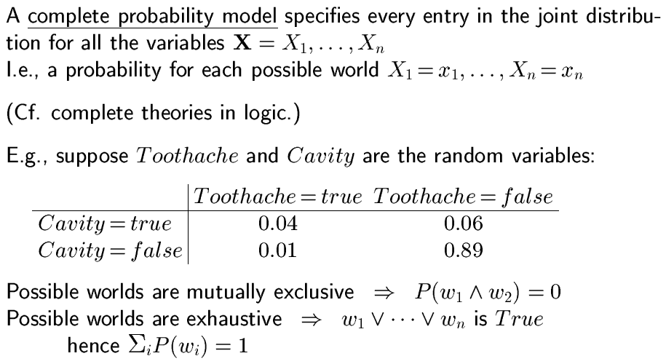
(extra slide) Full Joint (discrete) Distributions

Slide 23
(extra) How many “possible worlds” in a Discrete Distribution?
How many possible worlds ?
For P(X,Y), where X,Y are binary variables, it is 2x2
For P(X,Y=y), it is 2x1
In general, the number of possible worlds
Is the product of the size of each variable

Slide 24
Two Key Elements in Probability (Extra slide)
Probability Distribution Model
Variables, Value assignments (possible worlds)
Represented as a table or a graph
Inferences can be made from the model
(1) Sum rule
(2) Product rule
(3) Conditional
(4) Normalization
(5) Marginalization

Slide 25
(extra slide) Remember Two Inference Rules
Rules: You only need to remember two ☺
Rule (1) Sum axiom:
P(A|B) + P(~A|B) = 1
Rule (2) Product axiom for P(A^B):
P(AB|C) = P(A|C) P(B|AC) = P(B|C) P(A|BC)
Notations
Variable X, value x_{i}, P(X=x_{i}),
P(X) denotes for all values of X as shown in the table, aka “joint probability distribution”
Mixed variables and values: P(X,Y), P(X, y)
Remember these two
And That is all !!!

Slide 26
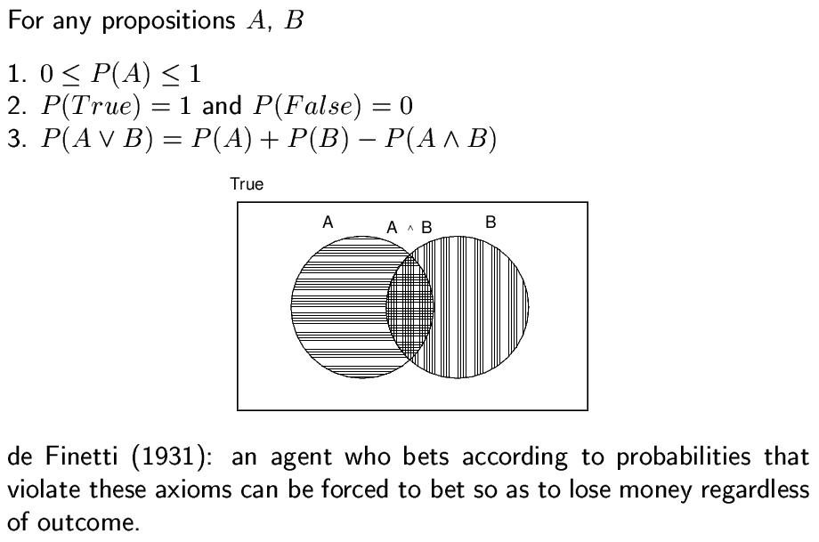
(Extra slide) Inference for P(A v B)
P(A+B) = P(~~(A+B))
=P(~(~A~B))=1-P(~A~B)
So you can use (2)

Slide 27

Complex Inference of Propositions
Can also infer values of complex propositions in the same manner
Sum over all action events in which proposition is true
P(toothache ∨ cavity)
= .108 + .012 + .016 + .064 + .072 + .008 = .28
P(toothache ∧ cavity)
= .108 + .012 = .12
P(toothache ⇒ cavity)
= .108 +.012 +.072 + .008 + .144 + .576 = .92
P(cavity ⇒ toothache)
= .108 +.012 +.016 + .064 + .144 + .576 = .92

Slide 28
Two Key Elements in Probability (Extra slide)
Probability Distribution Model
Variables, Value assignments (possible worlds)
Represented as a table or a graph
Inferences can be made from the model
(1) Sum rule
(2) Product rule
(3) Conditional
(4) Normalization
(5) Marginalization

Slide 29
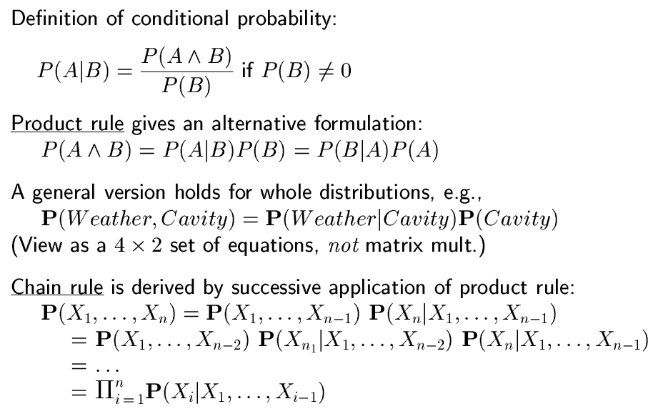
(3) Conditional Probability P(A|B) (extra slide)
Derivable from (2)
(2)

Slide 30
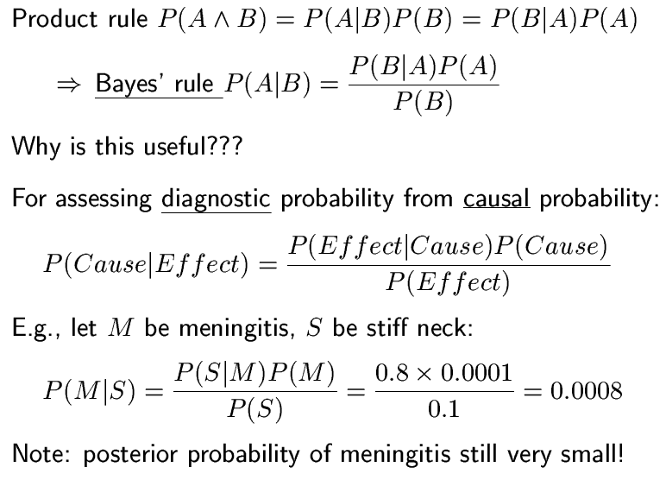
Bayes’ Rule: derivable from (2) (extra slide)

Slide 31
Probabilities and Evidence
Degrees of belief (subjective probabilities) are centrally affected by evidence
Prior probability refers to degree of belief before see any evidence
P(sunny)=.5
P(aincourse)=.45
Conditional probability refers to degree of belief conditioned on seeing (only) particular evidence
P(sunny | losangeles,july)=.9
P(sunny | pittsburgh)=.1
P(aincourse | aonmidterm)=.6

Slide 32
Conditional Probability
Definition of conditional probability:
P(a | b) = P(a ∧ b) / P(b) if P(b) > 0
E.g. P(cavity | toothache) = P(cavity ∧ toothache)/P(toothache)
What percentage of cases with toothache have a cavity?
Product rule gives an alternative formulation:
P(a ∧ b) = P(a | b) P(b) = P(b | a) P(a)
A general version holds for distributions
P(X,Y) = P(X | Y) P(Y)
E.g., P(Weather,Cavity) = P(Weather | Cavity) P(Cavity)
Equivalent to a 4 × 2 set of equations, not matrix multiplication
P(sunny,cavity) = P(sunny | cavity) P(cavity)
P(sunny,¬cavity) = P(sunny | ¬cavity) P(¬cavity)
P(rainy,cavity) = P(rainy | cavity) P(cavity)
…
CP may also be referred to as posterior probability
Probability after have seen evidence
Comma (,) equivalent to AND (∧)

Slide 33
Inference w/ Conditional Probabilities
Can compute conditional probabilities by enumerating over joint distribution via:
P(a | b) = P(a ∧ b) / P(b)
P(cavity | toothache)
= P(cavity ∧ toothache)/P(toothache)
= (.108 + .012)/(.108 + .012 + .016 + .064) = .12/.2 = .6
P(¬cavity | toothache)
= P(¬cavity ∧ toothache)/P(toothache)
= (.016 + .064)/(.108 + .012 + .016 + .064) = .08/.2 = .4
1/P(toothache) is the normalization constant (α) for the distribution
P(Cavity | toothache)
Ensures it sums to 1

Slide 34
Inference w/ Conditional Probabilities
Can compute conditional probabilities by enumerating over joint distribution via:
P(a | b) = P(a ∧ b) / P(b)
P(cavity | toothache)
= P(cavity ∧ toothache)/P(toothache)
= (.108 + .012)/(.108 + .012 + .016 + .064) = .12/.2 = .6
P(¬cavity | toothache)
= P(¬cavity ∧ toothache)/P(toothache)
= (.016 + .064)/(.108 + .012 + .016 + .064) = .08/.2 = .4
1/P(toothache) is the normalization constant (α) for the distribution P(Cavity | toothache)
Ensures it sums to 1

Slide 35
Two Key Elements in Probability (Extra slide)
Probability Distribution Model
Variables, Value assignments (possible worlds)
Represented as a table or a graph
Inferences can be made from the model
(1) Sum rule
(2) Product rule
(3) Conditional
(4) Normalization
(5) Marginalization

Slide 36
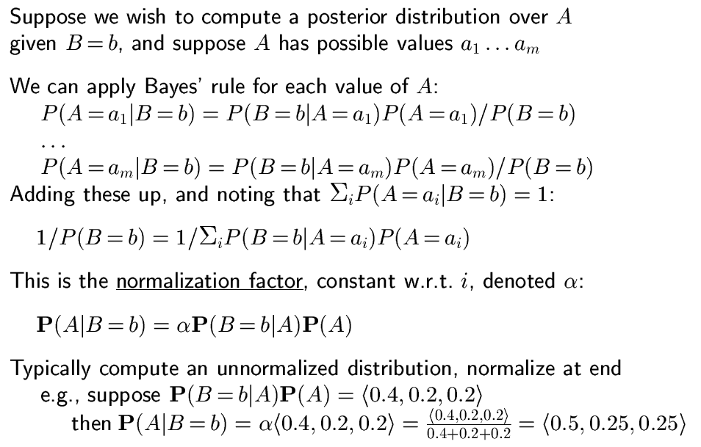
(4) Normalization (“make the distribution add to 1”)
= α
= α P(B=b ^ A)

Slide 37
Normalization Example
Cavity | Catch | Toothache | Logic Truth | Probability
0 | 0 | 0 | {0,1} | 0.576
0 | 0 | 1 | {0,1} | 0.064
0 | 1 | 0 | {0,1} | 0.144
0 | 1 | 1 | {0,1} | 0.016
1 | 0 | 0 | {0,1} | 0.008
1 | 0 | 1 | {0,1} | 0.012
1 | 1 | 0 | {0,1} | 0.072
1 | 1 | 1 | {0,1} | 0.108
P( Toothache | Cavity=1) =
αP(Cavity=1 ^ Toothache) =
α <0.108+0.012, 0.072+0.008> =
α <0.12, 0.08> =
<0.12/0.2, 0.08/0.2> =
<0.6, 0.4>
 | Toothache |  | ~Toothache
 | Catch | ~Catch | Catch | ~Catch
Cavity | 0.108 | 0.012 | 0.072 | 0.008
~Cavity | 0.016 | 0.064 | 0.144 | 0.576

Slide 38
Normalization once for all?
If you use the inference rules properly, then normalization would be preserved
For the last example, we may use product rule
P(Toothache|Cavity=1) = α P(Cavity=1 ^ Toothache)
P(Toothache|Cavity=1) = P(Cavity=1^Toothache) / P(Cavity=1)
The results will be the same
Try it

Slide 39
Normalized Inference Procedure
General inference procedure for cond. distributions:
P(X | e) = P(X,e)/P(e) = αP(X,e) = αΣ_{y}P(X,e,y)
X is a single query variable
e is a vector of values of the evidence variables E
y is a vector of values for the remaining unobserved variables Y
P(X,e,y) is a subset of values from the joint probability distribution
Dentistry example
P(Cavity | toothache)
= P(Cavity,toothache)/P(toothache)
= αP(Cavity,toothache)
= α[P(Cavity,toothache,catch)+P(Cavity,toothache,¬catch)]
= (1/.2)[⟨.108,0.016⟩ + ⟨.012,.064⟩] = 5⟨.12,.08⟩ = ⟨.6,.4⟩
Only problem, but a big one, is that this does not scale well
If there are n Boolean variables, space and time are O(2^{n})
Will look shortly at independence as a means of dealing with this

Slide 40
Two Key Elements in Probability (Extra slide)
Probability Distribution Model
Variables, Value assignments (possible worlds)
Represented as a table or a graph
Inferences can be made from the model
(1) Sum rule
(2) Product rule
(3) Conditional
(4) Normalization
(5) Marginalization

Slide 41
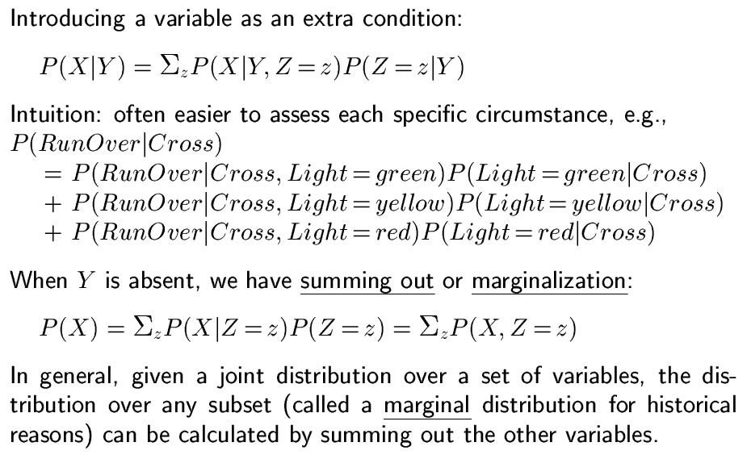
(5) Marginalization
Why? To plug in
the know numbers
Why? To plug in
the know numbers

Slide 42
Marginalization Example
 | Toothache |  | ~Toothache
 | Catch | ~Catch | Catch | ~Catch
Cavity | 0.108 | 0.012 | 0.072 | 0.008
~Cavity | 0.016 | 0.064 | 0.144 | 0.576
P( Toothache|Cavity ) =
P(Toothache|Cavity, Catch=1)P(Catch=1|Cavity)
+ P(Toothache|Cavity, Catch=0)P(Catch=0|Cavity)
P(Toothache) =
P(Toothache|Cavity=1, Catch=0)
+ P(Toothache|Cavity=0, Catch=0)
+ P(Toothache|Cavity=1, Catch=1)
+ P(Toothache|Cavity=0, Catch=1)
# possible worlds = 2x2
# possible worlds = 2

Slide 43
Probabilistic Inference by Enumeration
Can perform probabilistic inference by enumerating over (full) joint probability distribution
Analogous to model checking in propositional logic, but here we are summing probabilities over all action events rather than checking for satisfiability in one or all of the models
Start with the joint probability distribution P(Cavity,Toothache,Catch)
For any proposition φ, sum p for atomic events where true
P(φ) = Σ_{ω:ω╞φ} P(ω)
P(toothache)
= .108 + .012 + .016 + .064 = .2
P(cavity)
= .108 + .012 + .72 +.08 = .2
Catch refers to Dentist’s
instrument catching on tooth
Called marginal probability of toothache
The overall process is called marginalization or summing out: [P(Y) = Σ_{z}P(Y,z)]

Slide 44
Two Key Elements in Probability
Probability Distribution Model ✔
Variables, Value assignments (possible worlds)
Represented as a table or a graph
Inferences can be made from the model ✔
Sum rule ✔
Product rule ✔
Conditional ✔
Normalization ✔
Marginalization ✔

Slide 45
Summary of this ssesion
Probability is a rigorous formalism for uncertain knowledge
Conditional probabilities enable reasoning with uncertain evidence
A full joint probability distribution specifies the probability of every atomic event
Queries answerable by summing over probabilities of atomic events
Bayesian theorem/rule provides the basis for the most modern diagnostic reasoning in AI
Converts uncertain causal information into diagnostic conclusions
For nontrivial domains, we must find a way to reduce the size of the joint distribution
(Conditional) independence provides the tools

Slide 46
Multiple Sources of Evidence
As more sources of evidence accumulate, the conditional probability of cavity will adjust
E.g., if catch is also given, then have:
P(cavity | toothache,catch)
= P(cavity ∧ toothache ∧ catch)/P(toothache ∧ catch) = .87 (up from .6)
In general, as evidence accumulates over time, such as data from an x-ray, the conditional probability of cavity would continue to evolve
Probabilistic reasoning is inherently non-monotonic
However, if evidence is irrelevant, may simply ignore
P(cavity | toothache,sunny)
= P(cavity | toothache) = 0.6
Such reasoning about independence can be essential in making probabilistic reasoning tractable

Slide 47
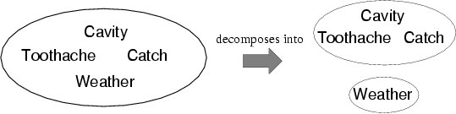
Independence
A and B are independent iff
P(A|B) = P(A) or P(B|A) = P(B) or P(A, B) = P(A) P(B)
E.g., P(Toothache, Catch, Cavity, Weather)
= P(Toothache, Catch, Cavity) P(Weather)
Reduces 2x2x2x4=32 entries to 2x2x2+4=12
For n independent coin tosses, O(2^{n})→O(n)
Analogous to goal decomposition in planning
Absolute (or marginal) independence is powerful but rare
E.g., dentistry is a large field with hundreds of variables, none of which are absolutely independent
What to do?

Slide 48
Conditional Independence
Two dependent variables may become conditionally independent when conditioned on a third variable
Consider Catch and Toothache
P(catch)=.34 while P(catch | toothache)=.62, so dependent
The problem is that while neither causes the other, they correlate because both caused by single underlying hidden variable (cavity)

Slide 49
Conditional Independence
Two dependent variables may become conditionally independent when conditioned on a third variable
If condition both Catch and Toothache on Cavity, conditional probabilities become independent
P(toothache, catch | cavity) = P(toothache | cavity) P(catch | cavity) = .54
P(toothache, catch | ¬cavity) = P(toothache | ¬cavity) P(catch | ¬cavity) = .02
Catch is conditionally independent of Toothache given Cavity:
P(Toothache, Catch | Cavity) = P(Toothache | Cavity) P(Catch | Cavity)
Additional equivalent statements:
P(Catch | Toothache,Cavity) = P(Catch | Cavity)
P(Toothache | Catch, Cavity) = P(Toothache | Cavity)

Slide 50
Conditional Independence…
General rule is P(X,Y | Z) = P(X | Z) P(Y | Z)
Or P(X | Y,Z) = P(X | Z) or P(Y | X,Z) = P(Y | Z)
With conditional independence can decompose individual large tables into sets of smaller ones, e.g.:
P(Toothache, Catch, Cavity)
= P(Toothache, Catch | Cavity) P(Cavity) [product rule]
= P(Toothache | Cavity) P(Catch | Cavity) P(Cavity) [cond. independence]
The use of conditional independence can reduce the size of the representation of the joint distribution from exponential in n to linear in n
For example, if there are many symptoms all caused by cavities
One of the most significant recent advances in AI, as has made probabilistic reasoning tractable where previously understood not to be so
Conditional independence is our most basic and robust form of knowledge about uncertain environments

Slide 51
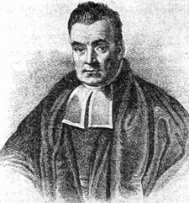
Bayes' Rule
Product rule: P(a ∧ b) = P(a | b) P(b)
P(a ∧ b) = P(b | a) P(a)
P(a | b) P(b) = P(b | a) P(a)
⇒ Bayes' rule: P(a | b) = P(b | a) P(a) / P(b)
Rev. Thomas Bayes
c. 1701 - 1761

Slide 52
Bayes' Rule
Bayes' rule: P(a | b) = P(b | a) P(a) / P(b)
Or in distribution form (with normalization factor)
P(Y | X) = P(X | Y) P(Y) / P(X) = αP(X | Y) P(Y)
Useful for deriving diagnostic probabilities from causal probabilities:
P(Cause | Effect) = P(Effect | Cause) P(Cause) / P(Effect)
E.g., let M be meningitis and S be stiff neck:
P(m | s) = P(s | m) P(m) / P(s) = 0.8 × 0.0001 / 0.1 = 0.0008
Although the probability of having a stiff neck is very high if have meningitis (.8), posterior probability of meningitis given a stiff neck is still very small (.0008)!

Slide 53
Bayes' Rule
Bayes' rule: P(a | b) = P(b | a) P(a) / P(b)
Or in distribution form (with normalization factor)
P(Y | X) = P(X | Y) P(Y) / P(X) = αP(X | Y) P(Y)
Useful for deriving diagnostic probabilities from causal probabilities:
Causal (and prior) probabilities often easier to obtain than diagnostic ones
Also may be more robust under shifts in baselines
E.g., in an epidemic P(m) may skyrocket, and estimates of P(m | s) based on pre-epidemic observation will be wrong.
But: P(s | m) remains fixed (causally determined)

Slide 54
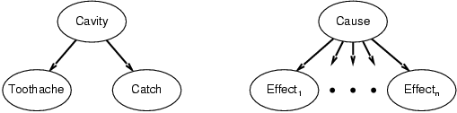
Combining Evidence (for Diagnosis) via Bayes' Rule and Conditional Independence
P(Cavity | toothache,catch)
= αP(toothache ∧ catch | Cavity) P(Cavity) [Bayes’ Rule]
= αP(toothache | Cavity) P(catch | Cavity) P(Cavity) [Cond. Ind.]
This is an example of a naïve Bayes model:
P(Cause,Effect₁, … ,Effect_{n}) = P(Cause) π_{i}P(Effect_{i}|Cause)
Cost of diagnostic reasoning now grows linearly rather than exponentially in number of conditionally independent effects
Called naïve, because often used when the effects are not completely conditionally independent given the cause
Such Bayesian classifiers can work surprisingly well even in the absence of complete conditional independence
Often focus of learning efforts

Slide 55
Decision Making under Uncertainty
Suppose I believe the following:
P(A₂₅ gets me there on time | …) = 0.04
P(A₉₀ gets me there on time | …) = 0.70
P(A₁₂₀ gets me there on time | …) = 0.95
P(A₁₄₄₀ gets me there on time | …) = 0.9999
Where A_{n} means leave for airport n minutes before flight
Which action should I choose?
Depends on preferences for missed flight vs. waiting time
Utility theory is generally used to represent and infer preferences
Numeric desirability values are assigned to outcomes
Although other approaches are possible
E.g. “prefer A to B”
Decision theory = probability theory + utility theory

Slide 56
Core of Decision Theory
Choose action/option w/ highest expected utility
For each action/option, sum across all possible outcomes reachable via it; weighting the utility of each outcome by the probability of reaching it
Agent chooses
Expected U:
5.8
A
-1
B
-2.4
C
Chance
.2
.4
.4
.3
.7
.1
.3
.6
D
E
F
G
H
I
J
K
Utilities: 5 2 10 -50 20 0 4 -6
Weighted U:
1
.8
4
-15
14
0
1.2
-3.6
Notes:
WU: Weighted Utility
EU: Expected Utility

Slide 57
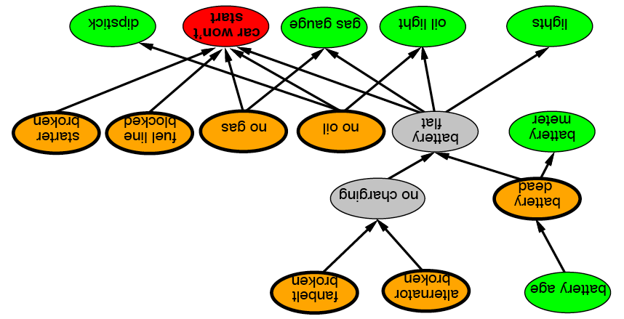

Bayesian Network (Chap. 14) (14.5 & 14.6 optional)
Graphical notation for (conditional) independence
Compact specification of full joint probability distribution
Also called belief networks, probabilistic networks, directed graphical models, causal networks (especially when used without probabilities) and knowledge maps
Notes:
Car diagnosis
Think of the causal relationships

Slide 58
Syntax
A set of nodes, one per variable
Links between nodes encoding direct influences
Yielding a directed, acyclic graph
A conditional distribution for each node given its parents:
P (X_{i} | Parents(X_{i}))
In simplest case, represented as a conditional probability table (CPT)
Provides distribution over X_{i} for each combination of parent values
Reduces to prior probabilities for nodes with no parents
City | Month | sunny | rainy
Pittsburgh | January | .4 | .2
Pittsburgh | February | .3 | .3
Los Angeles | January | .7 | .2
City
Month
…
Weather
.
.
.

Slide 59
Belief (Bayesian) Networks
Motivation
Conditional Independence
Syntax and Semantics
Reasoning with Belief Networks
Construction of Belief Networks
Inference Algorithms
Exact inference
Approximate inference

Slide 60
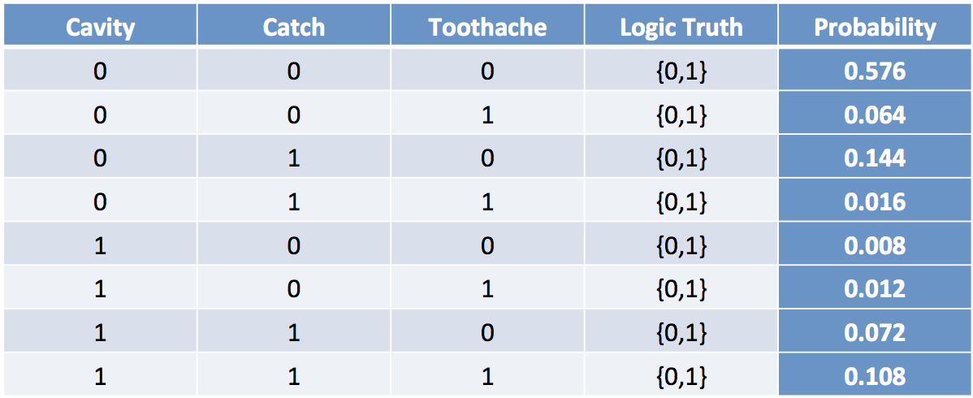
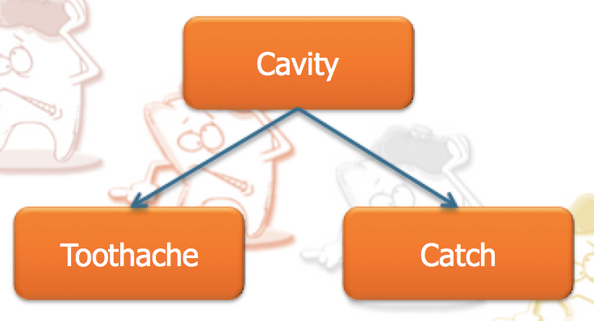

Why Need Bayesian Networks?
A better representation for the Probability Distribution Model
(take advantage of “variable independence”)
Fully Joint Distribution Table
Bayesian Network
⬅➔
P(X₁, X₂, …, X_{n})
Size = O(d^{n})
d: variable domain
⬅➔
Size = O(nd^{k})
k: # of parents

Slide 61
Belief (Bayesian) Networks
Motivation
Conditional Independence
Syntax and Semantics
Reasoning with Belief Networks
Construction of Belief Networks
Inference Algorithms
Exact inference
Approximate inference

Slide 62
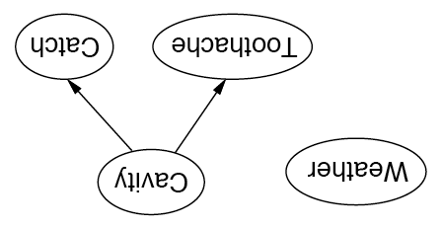
Independence in Bayesian Networks
Topology of network encodes (conditional) independence assertions:
Weather is independent of the other variables
Toothache and Catch are conditionally independent given Cavity

Slide 63
Dental Network
P(Cavity)
0.200
Weather
Cavity
Conditional Probability Table (CPT)
Toothache
Catch
 | P(Toothache)
Cavity | 0.600
¬Cavity | 0.100
 | P(Catch)
Cavity | 0.900
¬Cavity | 0.200
Notes:
Terminology

Slide 64
Alarm Example
My burglar alarm is fairly reliable, but is sometimes set off by a minor earthquake. Neighbors John and Mary promise to call if they hear the alarm, but sometimes make errors (John may call when he hears the phone ringing and Mary may miss the alarm when listening to music).
John has just called, but Mary hasn’t. Is there a burglar?
The evidence is subject to errors of both omission and commission
Variables
Burglary, Earthquake, Alarm, JohnCalls, MaryCalls
Could also have PhoneRang and ListeningToMusic, etc.
Network topology reflects "causal" knowledge:
A burglar can set off the alarm
An earthquake can set off the alarm
The alarm can cause Mary to call
The alarm can cause John to call

Slide 65
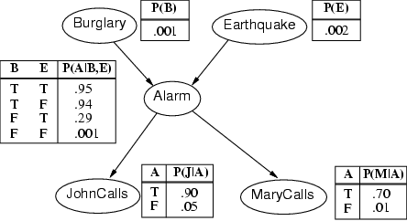
Compactness/Efficiency
A Conditional Probability Table (CPT) for Boolean X_{i} with k Boolean parents has 2^{k} rows for the combinations of parent values
If each of the n variables has no more than k parents, the complete network requires O(n · 2^{k}) numbers
I.e., grows linearly with n vs. O(2^{n}) for the full joint distribution
For burglary net, 1+1+4+2+2=10 numbers (vs. 2⁵-1=31)

Slide 66
Belief (Bayesian) Networks
Motivation
Conditional Independence
Syntax and Semantics
Reasoning with Belief Networks
Construction of Belief Networks
Inference Algorithms
Exact inference
Approximate inference

Slide 67
Semantics
If correct, the network represents the full joint distribution: P(x₁, … ,x_{n}) = π_{i=1} P(x_{i} | parents(X_{i}))
n

Slide 68
P(x₁, … ,x_{n}) = π_{i=1} P(x_{i} | parents(X_{i}))
E.g., the probability of a complete false alarm (no burglary or earthquake) with two calls is:
P(j, m, a, ¬b, ¬e)
= P(j | a) P(m | a) P(a | ¬b, ¬e) P(¬b) P(¬e)
= .9 x .7 x .001 x .999 x .998 ≈ .000063
n

Slide 69
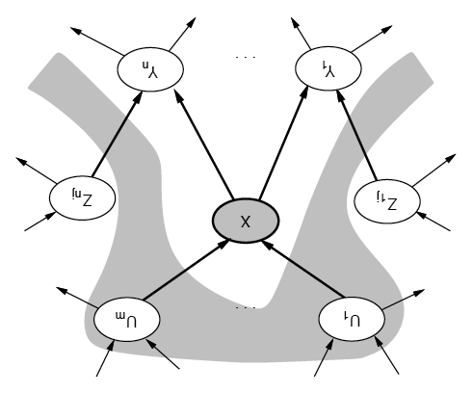
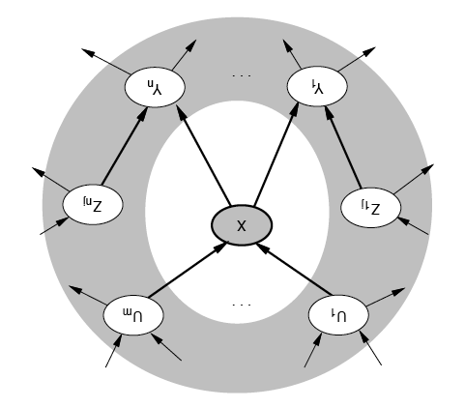
Conditional Independence of Nodes
A node is conditionally independent of its nondescendents given its parents
A node is conditionally independent of all others given its Markov blanket
Parents, children and children’s parents

Slide 70
Alarm Network
Burglary
Earthquake
Alarm
JohnCalls
MaryCalls
Notes:
An example so old, they were using back when I was learning Bayesian networks.
Notice that we could include the factors that lead to burglaries or earthquakes, or the factors that might make John and Mary more or less likely to call, but we don’t

Slide 71
Alarm Network
Burglary
Earthquake
Alarm
John’s and Mary’s calls are directly influenced by the alarm
JohnCalls
MaryCalls
Notes:
What can we learn from this network structure?

Slide 72
Alarm Network
Burglary
Earthquake
John’s and Mary’s calls are conditionally independent of burglaries or earthquakes given the value of alarm
Alarm
JohnCalls
MaryCalls
Notes:
The absence of a link means conditional independence.
John calls because the alarm goes off, not because there’s a burglary or an earthquake.
If there’s a burglary, but no alarm, we shouldn’t expect John to call.

Slide 73
Alarm Network
Burglary
Earthquake
John’s and Mary’s calls are not independent of burglaries or earthquakes
Alarm
JohnCalls
MaryCalls
Notes:
Be sure to understand the difference between independence and conditional independence.
So these are all conclusions we can draw from just the graphical structure.
But it doesn’t really say anything about what direction or magnitude of the dependency is.
So we can’t tell from just the graph whether Alarm makes John’s call more or less likely. We can’t tell whether Burglary or Earthquake is a stronger influence on Alarm.

Slide 74
Belief (Bayesian) Networks
Motivation
Conditional Independence
Syntax and Semantics
Reasoning with Belief Networks
Construction of Belief Networks
Inference Algorithms
Exact inference
Approximate inference

Slide 75
Bayesian Network Inference
Compute P(query variables | evidence variables)
e.g., John and Mary both call; was there a burglary?
John, Mary are True
Burglary is the query variable
Earthquake and Alarm are hidden variables

Slide 76
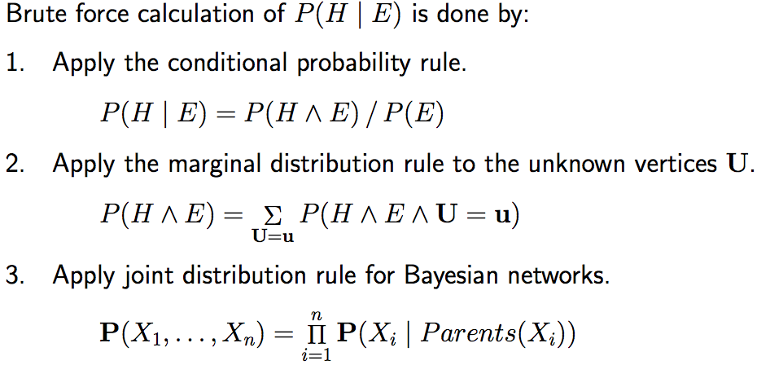
Enumeration Algorithm (extra)
The Key Ideas Are:

Slide 77
Inference by Enumeration
John and Mary both call; was there a burglary?
P(B | J, M)
= αP(B, J, M)
Using the marginalization formula, introduce hidden variables
= α∑_{A}∑_{E}P(B, J, M, E, A)
Using the product rule, break up into conditionals
= α∑_{A}∑_{E}P(B)·P(E | B)·P(A | B,E)·P(J | B,E,A)·P(M | B,E,A,J)
= α∑_{A}∑_{E}P(B)·P(E)·P(A | B, E)·P(J | A)·P(M | A)
Adding 4 numbers, each a product of 5 numbers
O(n2^{n}) in a network of n variables

Slide 78
Inference by Enumeration
John and Mary both call; was there a burglary?
P(B | J, M)
= αP(B, J, M)
Using the marginalization formula, introduce hidden variables
= α∑_{A}∑_{E}P(B, J, M, E, A)
Using the product rule, break up into conditionals
= α∑_{A}∑_{E}P(B)·P(E | B)·P(A | B,E)·P(J | B,E,A)·P(M | B,E,A,J)
= α∑_{A}∑_{E}P(B)·P(E)·P(A | B, E)·P(J | A)·P(M | A)
= αP(B) ∑_{E}P(E) ∑_{A}P(A | B, E)·P(J | A)·P(M | A)
O(2^{n}) in a network of n variables (instead of O(n2^{n}))

Slide 79
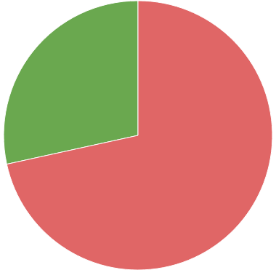
Inference by Enumeration
John and Mary both call; was there a burglary?
P(B | J, M)
= αP(B, J, M)
Using the marginalization formula, introduce hidden variables
= α∑_{A}∑_{E}P(B, J, M, E, A)
Using the product rule, break up into conditionals
= α∑_{A}∑_{E}P(B)·P(E | B)·P(A | B,E)·P(J | B,E,A)·P(M | B,E,A,J)
= αP(B) ∑_{E}P(E) ∑_{A}P(A | B, E)·P(J | A)·P(M | A)
= α0.000592
P(¬B | J, M)
= αP(¬B) ∑_{E}P(E) ∑_{A}P(A | ¬B, E)·P(J | A)·P(M | A)
= α0.00149
P(B | J, M) = 0.284 = 28.4%
Notes:
The posterior probability of a burglary is much higher than it was before, it’s still much lower than 50%.
Because earthquake is more likely than burglary

Slide 80
Inference by Enumeration
John and Mary both call; was there a burglary?
P(B | J, M)
= αP(B, J, M)
Using the marginalization formula, introduce hidden variables
= α∑_{A}∑_{E}P(B, J, M, E, A)
Using the product rule, break up into conditionals
= α∑_{A}∑_{E}P(B)·P(E | B)·P(A | B,E)·P(J | B,E,A)·P(M | B,E,A,J)
= αP(B) ∑_{E}P(E) ∑_{A}P(A | B, E)·P(J | A)·P(M | A)
= α0.000592
P(¬B | J, M)
= αP(¬B) ∑_{E}P(E) ∑_{A}P(A | ¬B, E)·P(J | A)·P(M | A)
= α0.00149
P(B | J, M) = 0.284 = 28.4%

Slide 81
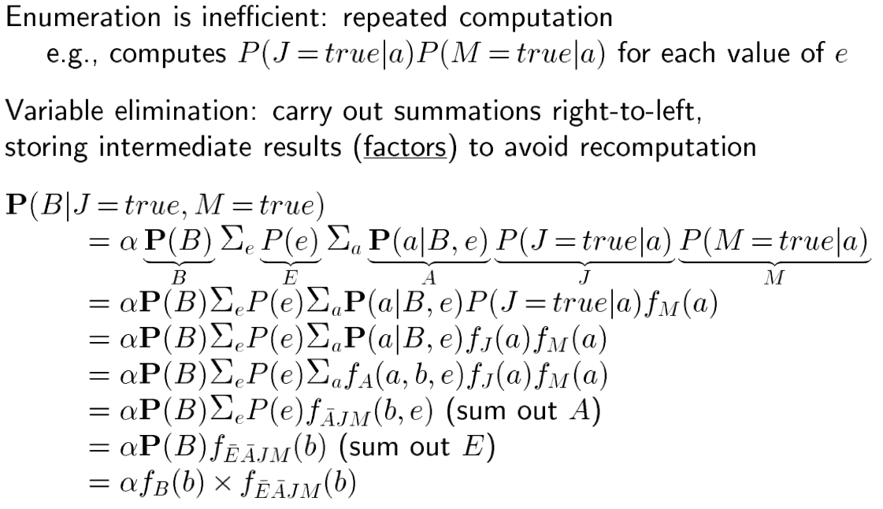
(extra slide) Variable Elimination Algorithm

Slide 82
Variable Elimination
Dynamic programming to save results
P(B) ∑_{E}P(E) ∑_{A}P(A | B, E) P(J | A) P(M | A)
f₄(A) f₅(A)
J and M are evidence
Compute the table for each factor
f₅(A) = ⟨P(M | A), P(M | ¬A)⟩ = ⟨0.70, 0.01⟩
f₄(A) = ⟨P(J | A), P(J | ¬A)⟩ = ⟨0.90, 0.05⟩

Slide 83
Variable Elimination
Dynamic programming to save results
P(B) ∑_{E}P(E) ∑_{A}P(A | B, E) P(J | A) P(M | A)
f₃(A,B,E) f₄(A) f₅(A)
Eliminate A
Compute the table for each factor
f₅(A) = ⟨P(M | A), P(M | ¬A)⟩ = ⟨0.70, 0.01⟩
f₄(A) = ⟨P(J | A), P(J | ¬A)⟩ = ⟨0.90, 0.05⟩
f₃(A,B,E) = ⟨P(A|B,E), P(A|B,¬E), P(¬A|B,E), P(¬A|B,¬E)⟩ = ⟨0.95, 0.94, 0.05, 0.06⟩

Slide 84
Variable Elimination
Dynamic programming to save results
P(B) ∑_{E}P(E) ∑_{A}P(A | B, E) P(J | A) P(M | A)
f₂(E) f₃(A,B,E) f₄(A) f₅(A)
Eliminate E
Compute the table for each factor
f₅(A) = ⟨P(M | A), P(M | ¬A)⟩ = ⟨0.70, 0.01⟩
f₄(A) = ⟨P(J | A), P(J | ¬A)⟩ = ⟨0.90, 0.05⟩
f₃(A,B,E) = ⟨P(A|B,E), P(A|B,¬E), P(¬A|B,E), P(¬A|B,¬E)⟩ = ⟨0.95, 0.94, 0.05, 0.06⟩
f₂(E) = ⟨P(E), P(¬E)⟩= ⟨0.002, 0.998⟩

Slide 85
Variable Elimination
Dynamic programming to save results
P(B) ∑_{E}P(E) ∑_{A}P(A | B, E) P(J | A) P(M | A)
f₁(B) f₂(E) f₃(A,B,E) f₄(A) f₅(A)
B is the query
Compute the table for each factor
f₅(A) = ⟨P(M | A), P(M | ¬A)⟩ = ⟨0.70, 0.01⟩
f₄(A) = ⟨P(J | A), P(J | ¬A)⟩ = ⟨0.90, 0.05⟩
f₃(A,B,E) = ⟨P(A|B,E), P(A|B,¬E), P(¬A|B,E), P(¬A|B,¬E)⟩ = ⟨0.95, 0.94, 0.05, 0.06⟩
f₂(E) = ⟨P(E), P(¬E)⟩= ⟨0.002, 0.998⟩
f₁(B) = P(B) = 0.001

Slide 86
Variable Elimination
Dynamic programming to save results
P(B) ∑_{E}P(E) ∑_{A}P(A | B, E) P(J | A) P(M | A)
f₁(B) f₂(E) f₃(A,B,E) f₄(A) f₅(A)
Compute the table for each factor
f₅(A) = ⟨P(M | A), P(M | ¬A)⟩ = ⟨0.70, 0.01⟩
f₄(A) = ⟨P(J | A), P(J | ¬A)⟩ = ⟨0.90, 0.05⟩
f₃(A,B,E) = ⟨P(A|B,E), P(A|B,¬E), P(¬A|B,E), P(¬A|B,¬E)⟩ = ⟨0.95, 0.94, 0.05, 0.06⟩
f₂(E) = ⟨P(E), P(¬E)⟩= ⟨0.002, 0.998⟩
f₁(B) = P(B) = 0.001
Reusable for P(¬B | J, M)

Slide 87
Variable Elimination
Dynamic programming to save results
P(B) ∑_{E}P(E) ∑_{A}P(A | B, E) P(J | A) P(M | A)
f₁(B) f₂(E) f₃(A,B,E) f₄(A) f₅(A)
Compute the table for each factor
f₅(A) = ⟨P(M | A), P(M | ¬A)⟩ = ⟨0.70, 0.01⟩
f₄(A) = ⟨P(J | A), P(J | ¬A)⟩ = ⟨0.90, 0.05⟩
f₃(A,B,E) = ⟨P(A|B,E), P(A|B,¬E), P(¬A|B,E), P(¬A|B,¬E)⟩ = ⟨0.95, 0.94, 0.05, 0.06⟩
f₂(E) = ⟨P(E), P(¬E)⟩= ⟨0.002, 0.998⟩
f₁(B) = P(B) = 0.001
Reusable for P(¬B | J, M)
*Eliminated variables in “bottom-up” order
Notes:
To see why order matters, let’s look at how we build the network in the first place.

Slide 88
Belief (Bayesian) Networks
Motivation
Conditional Independence
Syntax and Semantics
Reasoning with Belief Networks
Exact inference
Construction of Belief Networks
Inference Algorithms
Exact inference
Approximate inference

Slide 89
Constructing Networks
Pick a set of variables and order them
{Burglary, Earthquake, Alarm, JohnCalls, MaryCalls}
Loop through variables in order
Add node to the network
Determine its parents from only nodes already in the network
Write down the CPT for the node given its parents

Slide 90
Alarm Network
{Burglary, Earthquake, Alarm, JohnCalls, MaryCalls}
Notes:
Let’s observe this process in action. Here’s an order. We pick the first variable and add a node.

Slide 91
Alarm Network
{Burglary, Earthquake, Alarm, JohnCalls, MaryCalls}
Burglary
Notes:
There are no other nodes yet, so no links to draw

Slide 92
Alarm Network
{Burglary, Earthquake, Alarm, JohnCalls, MaryCalls}
Burglary
Earthquake
Notes:
Earthquake is independent of Burglary, so no link to draw

Slide 93
Alarm Network
{Burglary, Earthquake, Alarm, JohnCalls, MaryCalls}
Burglary
Earthquake
Alarm
Notes:
Add Alarm, which does depend on B & E

Slide 94
Alarm Network
{Burglary, Earthquake, Alarm, JohnCalls, MaryCalls}
Burglary
Earthquake
Alarm

Slide 95
Alarm Network
{Burglary, Earthquake, Alarm, JohnCalls, MaryCalls}
Burglary
Earthquake
Alarm
JohnCalls
Notes:
John needs a link from Alarm, but is conditionally independent of B & E

Slide 96
Alarm Network
{Burglary, Earthquake, Alarm, JohnCalls, MaryCalls}
Burglary
Earthquake
Alarm
JohnCalls

Slide 97
Alarm Network
{Burglary, Earthquake, Alarm, JohnCalls, MaryCalls}
Burglary
Earthquake
Alarm
JohnCalls
MaryCalls
Notes:
Likewise for Mary

Slide 98
Alarm Network
{Burglary, Earthquake, Alarm, JohnCalls, MaryCalls}
Burglary
Earthquake
Alarm
JohnCalls
MaryCalls
Notes:
Likewise for Mary

Slide 99
Alarm Network
{MaryCalls, JohnCalls, Alarm, Earthquake, Burglary}
Notes:
What if we reversed our order?

Slide 100
Alarm Network
{MaryCalls, JohnCalls, Alarm, Earthquake, Burglary}
MaryCalls
Notes:
First we add Mary, and there are no other nodes.

Slide 101
Alarm Network
{MaryCalls, JohnCalls, Alarm, Earthquake, Burglary}
JohnCalls
MaryCalls
Notes:
Then we add John. Now John is conditionally independent of Mary given Alarm, but we don’t have Alarm here. And John is dependent on Mary if Alarm is present. After all, they’re calling for the same reason.

Slide 102
Alarm Network
{MaryCalls, JohnCalls, Alarm, Earthquake, Burglary}
Alarm
JohnCalls
MaryCalls
Notes:
If John calls, the alarm is more likely to have gone off. Same with Mary. And even more so if both of them. Not conditionally independent of either

Slide 103
Alarm Network
{MaryCalls, JohnCalls, Alarm, Earthquake, Burglary}
Alarm
JohnCalls
MaryCalls
Notes:
If John calls, the alarm is more likely to have gone off. Same with Mary. And even more so if both of them. Not conditionally independent of either

Slide 104
Alarm Network
{MaryCalls, JohnCalls, Alarm, Earthquake, Burglary}
Earthquake
Alarm
JohnCalls
MaryCalls
Notes:
If the alarm goes off, that means it’s more likely to have been an earthquake. However, it doesn’t matter whether any calls come in.

Slide 105
Alarm Network
{MaryCalls, JohnCalls, Alarm, Earthquake, Burglary}
Earthquake
Alarm
JohnCalls
MaryCalls
Notes:
If the alarm goes off, that means it’s more likely to have been an earthquake. However, it doesn’t matter whether any calls come in.

Slide 106
Alarm Network
{MaryCalls, JohnCalls, Alarm, Earthquake, Burglary}
Burglary
Earthquake
Alarm
JohnCalls
MaryCalls
Notes:
Burglary also depends on Alarm
However, Earthquake also gives information, because if there’s an alarm, burglary may be more likely, but if there’s also an earthquake, then that would explain the alarm, making burglary less likely

Slide 107
Alarm Network
{MaryCalls, JohnCalls, Alarm, Earthquake, Burglary}
Burglary
Earthquake
Alarm
JohnCalls
MaryCalls
Notes:
Burglary also depends on Alarm
However, Earthquake also gives information, because if there’s an alarm, burglary may be more likely, but if there’s also an earthquake, then that would explain the alarm, making burglary less likely

Slide 108
Node Ordering
Put causes before effects
Links should flow in a causal, not diagnostic, direction
CPT contains P(Alarm | Burglary, Earthquake)
Bayesian network inference to compute P(Burglary | Alarm)
Causes will be available as parents when adding an effect
Otherwise, you’ll have to add compensatory links
And write bigger CPTs
Easier to elicit probabilities
It’s easier to write P(Alarm | Burglary) than P(Burglary | Alarm)
Only a heuristic
Finding the optimal ordering is still NP-hard
True for variable elimination as well

Slide 109
Belief (Bayesian) Networks
Motivation
Conditional Independence
Syntax and Semantics
Reasoning with Belief Networks
Exact inference
Construction of Belief Networks
Inference Algorithms
Exact inference (e.g., enumeration w/o variable elimination)
Approximate inference

Slide 110
Approximate Inference
Monte Carlo methods are most common
Treat network as a simulator
Run one simulation to get a sample of the distribution
At each node, “flip a coin” according to the CPT likelihoods
e.g., At Earthquake, the coin comes up True with prob. 0.002
As we get more samples, our answer becomes more accurate
Our first few flips for Earthquake might be FFFFFFFF…
But over time, the percentage of True flips will approach 0.002
Notes:
But still very complex

Slide 111
Direct Sampling
Sampling with no evidence
Burglary
Earthquake
Alarm
JohnCalls
MaryCalls

Slide 112
Direct Sampling
Sampling with no evidence
P(B)
0.001
Burglary
Earthquake
Alarm
JohnCalls
MaryCalls

Slide 113
Direct Sampling
Sampling with no evidence
P(B)
0.001
Burglary
Earthquake
Alarm
JohnCalls
MaryCalls

Slide 114
Direct Sampling
Sampling with no evidence
P(E)
0.002
P(B)
0.001
Burglary
Earthquake
Alarm
JohnCalls
MaryCalls

Slide 115
Direct Sampling
Sampling with no evidence
P(E)
0.002
P(B)
0.001
Burglary
Earthquake
Alarm
JohnCalls
MaryCalls

Slide 116
Direct Sampling
Sampling with no evidence
P(E)
0.002
P(B)
0.001
Burglary
Earthquake
 |  | P(A)
B | E | 0.95
B | ¬E | 0.94
¬B | E | 0.29
¬B | ¬E | 0.001
Alarm
JohnCalls
MaryCalls

Slide 117
Direct Sampling
Sampling with no evidence
P(E)
0.002
P(B)
0.001
Burglary
Earthquake
 |  | P(A)
B | E | 0.95
B | ¬E | 0.94
¬B | E | 0.29
¬B | ¬E | 0.001
Alarm
JohnCalls
MaryCalls

Slide 118
Direct Sampling
Sampling with no evidence
P(E)
0.002
P(B)
0.001
Burglary
Earthquake
 |  | P(A)
B | E | 0.95
B | ¬E | 0.94
¬B | E | 0.29
¬B | ¬E | 0.001
Alarm
 | P(J)
A | 0.90
¬A | 0.05
JohnCalls
MaryCalls

Slide 119
Direct Sampling
Sampling with no evidence
P(E)
0.002
P(B)
0.001
Burglary
Earthquake
 |  | P(A)
B | E | 0.95
B | ¬E | 0.94
¬B | E | 0.29
¬B | ¬E | 0.001
Alarm
 | P(J)
A | 0.90
¬A | 0.05
JohnCalls
MaryCalls

Slide 120
Direct Sampling
Sampling with no evidence
P(E)
0.002
P(B)
0.001
Burglary
Earthquake
 |  | P(A)
B | E | 0.95
B | ¬E | 0.94
¬B | E | 0.29
¬B | ¬E | 0.001
Alarm
 | P(M)
A | 0.70
¬A | 0.01
 | P(J)
A | 0.90
¬A | 0.05
JohnCalls
MaryCalls

Slide 121
Direct Sampling
Sampling with no evidence
P(E)
0.002
P(B)
0.001
Burglary
Earthquake
 |  | P(A)
B | E | 0.95
B | ¬E | 0.94
¬B | E | 0.29
¬B | ¬E | 0.001
Alarm
 | P(M)
A | 0.70
¬A | 0.01
 | P(J)
A | 0.90
¬A | 0.05
JohnCalls
MaryCalls

Slide 122
Direct Sampling
Reset and generate another sample
P(Event) =
# Samples with Event
Total # of Samples
Burglary
Earthquake
Alarm
JohnCalls
MaryCalls

Slide 123
Direct Sampling
P(Sample with All False) = 93.7%
P(E)
0.002
P(B)
0.001
Burglary
Earthquake
 |  | P(A)
B | E | 0.95
B | ¬E | 0.94
¬B | E | 0.29
¬B | ¬E | 0.001
Alarm
 | P(M)
A | 0.70
¬A | 0.01
 | P(J)
A | 0.90
¬A | 0.05
JohnCalls
MaryCalls
Notes:
A bit of a drawback

Slide 124
Rejection Sampling
Don’t waste time when sample contradicts evidence
Generate samples as in direct sampling
Reject samples that are inconsistent with evidence

Slide 125
Rejection Sampling
P(Burglary | Alarm)
Burglary
Earthquake
Alarm
JohnCalls
MaryCalls

Slide 126
Rejection Sampling
P(Burglary | Alarm)
P(B)
0.001
Burglary
Earthquake
Alarm
JohnCalls
MaryCalls

Slide 127
Rejection Sampling
P(Burglary | Alarm)
P(E)
0.002
P(B)
0.001
Burglary
Earthquake
Alarm
JohnCalls
MaryCalls

Slide 128
Rejection Sampling
P(Burglary | Alarm)
P(E)
0.002
P(B)
0.001
Burglary
Earthquake
 |  | P(A)
B | E | 0.95
B | ¬E | 0.94
¬B | E | 0.29
¬B | ¬E | 0.001
Alarm
JohnCalls
MaryCalls

Slide 129
Rejection Sampling
P(Burglary | Alarm)
P(E)
0.002
P(B)
0.001
Burglary
Earthquake
 |  | P(A)
B | E | 0.95
B | ¬E | 0.94
¬B | E | 0.29
¬B | ¬E | 0.001
Alarm
JohnCalls
MaryCalls

Slide 130
Rejection Sampling
P(Burglary | Alarm)
Reject
Reset
Repeat
Burglary
Earthquake
Alarm
JohnCalls
MaryCalls

Slide 131
Rejection Sampling
P(Burglary | Alarm)
Burglary
Earthquake
Alarm
JohnCalls
MaryCalls

Slide 132
Rejection Sampling
P(Burglary | Alarm)
P(Burglary | Alarm) =
# Samples with Burglary
Total # of Samples
Burglary
Earthquake
Alarm
JohnCalls
MaryCalls

Slide 133
Rejection Sampling
P(Rejected Sample) = P(¬Alarm) = 99.7%
P(E)
0.002
P(B)
0.001
Burglary
Earthquake
 |  | P(A)
B | E | 0.95
B | ¬E | 0.94
¬B | E | 0.29
¬B | ¬E | 0.001
Alarm
JohnCalls
MaryCalls

Slide 134
Likelihood Weighting
Don’t sample observed variables
Weight sample by likelihood of observed value
Given the parent values (possibly sampled, possibly observed)
Instead of equally weighting all samples
Normalize weights to get final probability
Notes:
Seems kind of obvious, but even if it’s obvious what you *want* to do, it’s not always obvious how to provably get the correct value out of what you want to do

Slide 135
Likelihood Weighting
P(Burglary | Alarm)
Sample Weight
P(E)
0.002
P(B)
0.001
Burglary
Earthquake
 |  | P(A)
B | E | 0.95
B | ¬E | 0.94
¬B | E | 0.29
¬B | ¬E | 0.001
Alarm
JohnCalls
MaryCalls

Slide 136
Likelihood Weighting
P(Burglary | Alarm)
Sample Weight
P(E)
0.002
P(B)
0.001
Burglary
Earthquake
 |  | P(A)
B | E | 0.95
B | ¬E | 0.94
¬B | E | 0.29
¬B | ¬E | 0.001
Alarm
JohnCalls
MaryCalls

Slide 137
Markov Chain Monte Carlo
Local search through sample states
e.g., Gibbs sampling
Evidence variables fixed to observed values
All other variables assigned to random values
Generate a new state by sampling one non-evidence variable
Conditioned on values of Markov blanket
i.e., Parents, children, and children’s parents
Increment count of this new state
Over time, the % of time in a state approaches its probability

Slide 138
Dempster-Shafer Theory
What does P(Alarm) = 0.5 mean?
Maybe we have no idea how likely the alarm is
Maybe we know for sure that the alarm goes off half the time
Probability distribution cannot express the difference
Belief functions
Maybe we have no idea how likely the alarm is
Bel(Alarm) = 0, Bel(¬Alarm) = 0
Maybe we know that the alarm goes off with a 50% chance
Bel(Alarm) = 0.5, Bel(¬Alarm) = 0.5
Maybe we’re 90% sure the alarm goes off with a 50% chance
Bel(Alarm) = 0.9*0.5 = 0.45, Bel(¬Alarm) = 0.9*0.5 = 0.45
But hard to determine the right decision (See Ch. 16)

Slide 139
Fuzzy Logic
Set membership is no longer True/False
“Nate is tall”
Traditionally, Nate would be in the set of tall people or not
Logically, Tall(Nate) would return True or False
Fuzzy set theory uses truth values from 0 to 1
T(Tall(Nate)) indicates the degree to which Nate is tall
Not a representation of uncertainty
Logical operators defined over fuzzy predicates

Slide 140
Beyond Propositions
First-Order Probability
Possible worlds with relations and objects
and predicates and functions to represent them
Relational Probability Models
One way of achieving first-order probability
Use database semantics
Context-specific independence
Solve by propositionalization
Or by lifted inference

Slide 141
What you should know
What are the sources for uncertainty?
How can we use probability to reason about uncertainty?
What is a random variable? Atomic events? How are they used for inference?
What is independence? What is conditional independence? Why are they needed for reasoning about uncertainty?
What is Bayes rule? How is this addressing combining evidence for diagnosis?
Bayesian networks provide a natural representation for (causally induced) conditional independence
Topology + CPTs = compact representation of joint distribution

Slide 142
Want more?
Try exercise 13.4,7,8,13,15, 14.2,4,8 in AIMA

